Slide 1
Endemic circulation in
animal reservoir
Stuttering transmission in humans
R < 1
Sustainable transmission in humans
R > 1
†
†
†
Adaptation in stuttering chains of transmission, R₀ increasing
Further evolution to high
transmissibility, R₀ increasing
Introduction
(from reservoir)
Incipient epidemic (R > 1)
(R >> 1)
Extinction
Emergence
Continued evolution

Slide 2
Endemic circulation in
animal reservoir
Stuttering transmission in humans
R_{e} < 1
Sustainable transmission in humans
R_{e} > 1
†
†
†
Adaptation in stuttering chains of transmission, R₀ increasing
Further evolution to high
transmissibility, R₀ increasing
Introduction
(from reservoir)
Incipient epidemic (R_{e} > 1)
(R_{e} >> 1)
Extinction
Emergence
Continued evolution

Slide 3
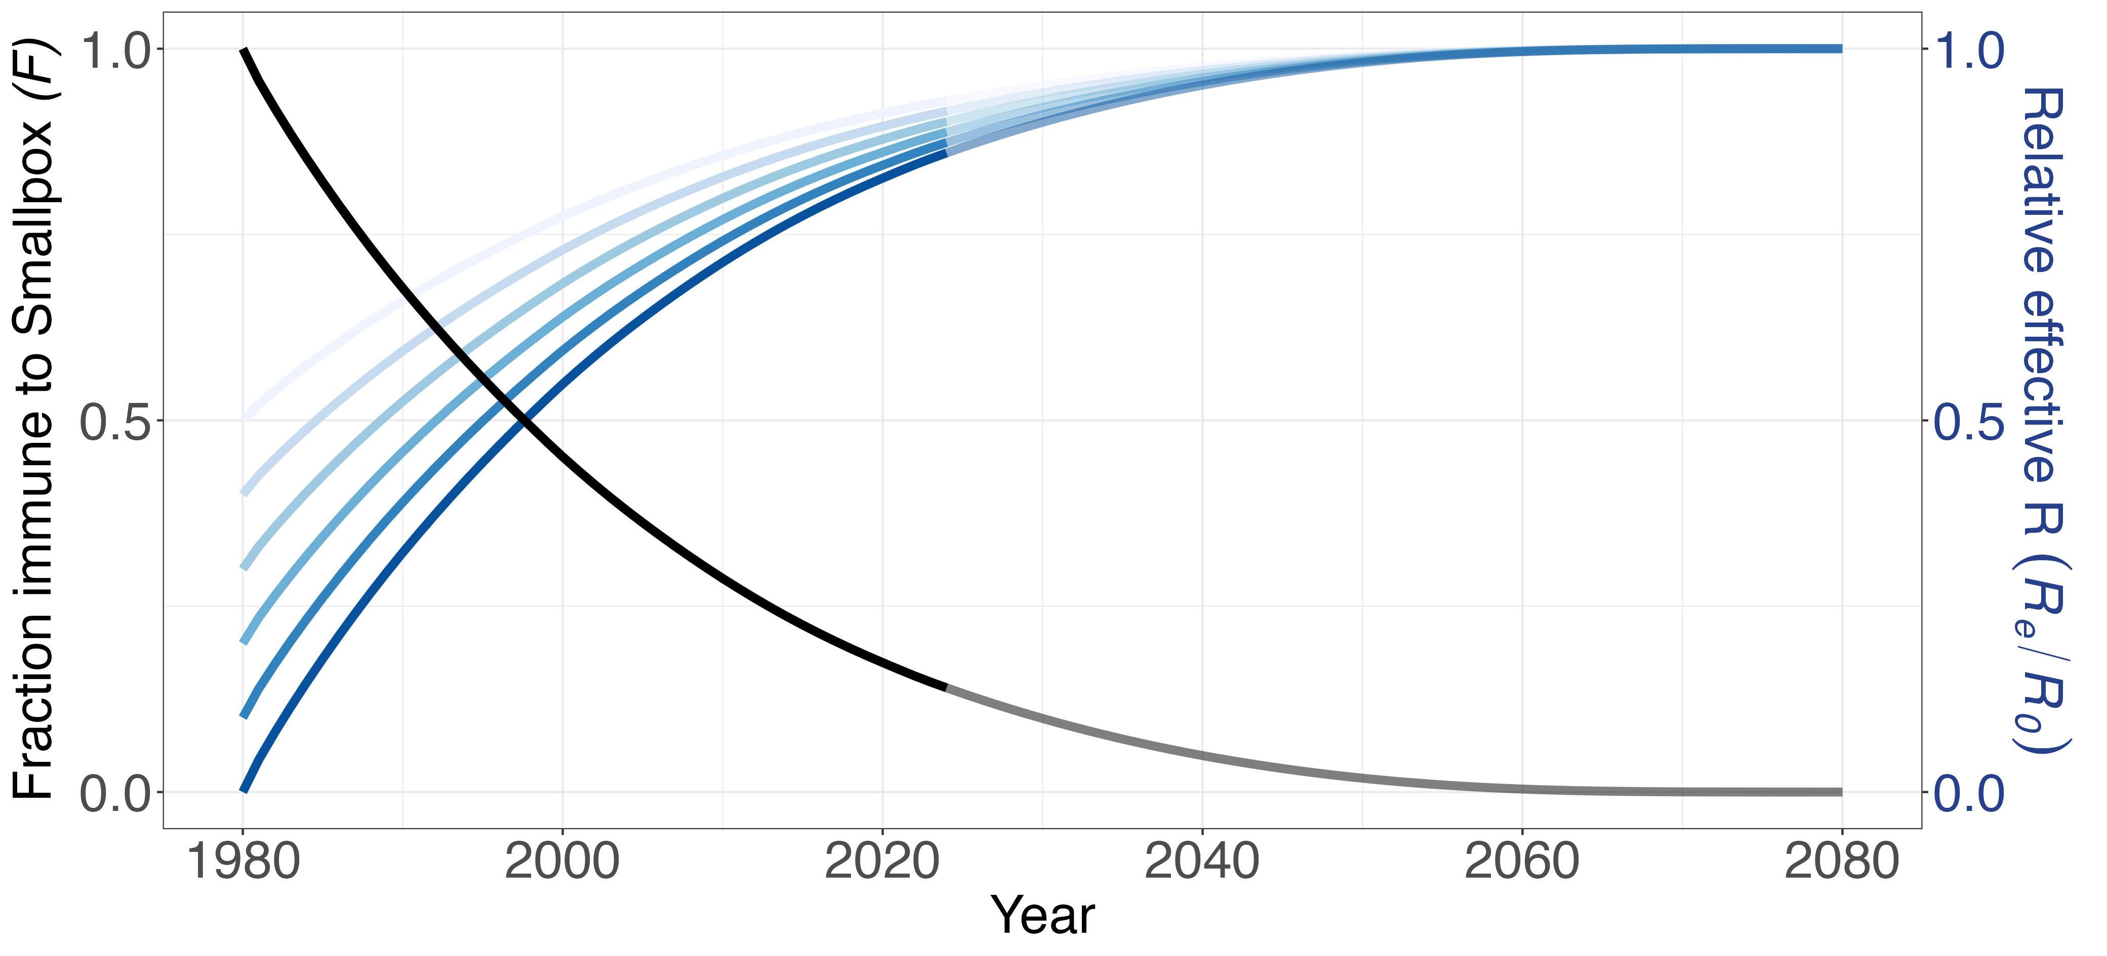
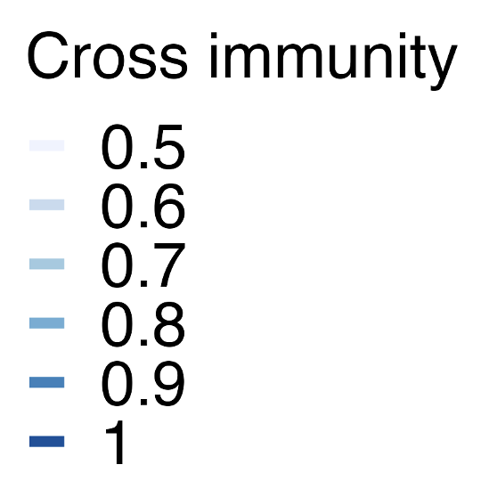

Slide 4
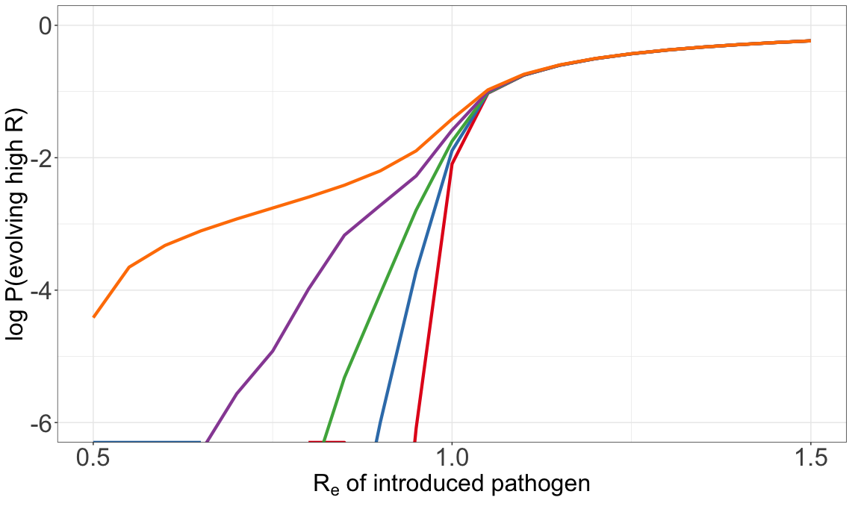
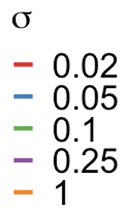
Notes:
Selective advantage after sigma
Aspect ratio – golden ratio
P(evolving high R0)

Slide 5
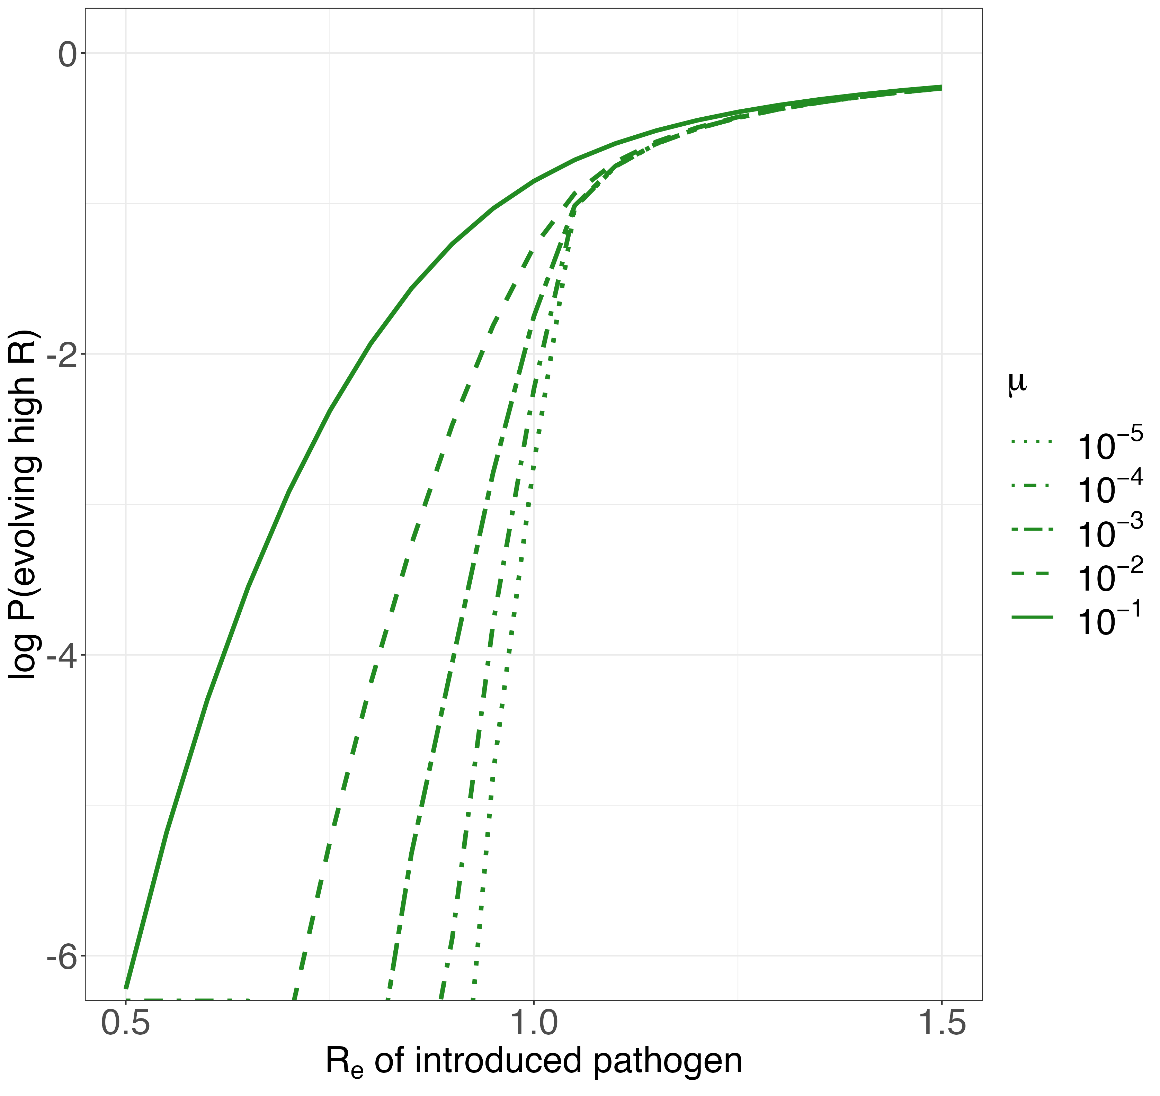
Notes:
Mu – beneficial mutation rate infection-1
P(evolving high transmissibility)
Take out 10^-1

Slide 6
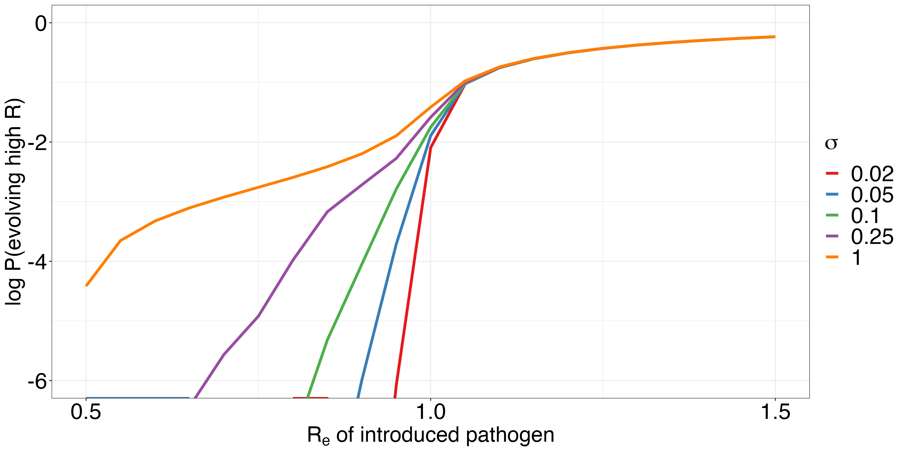
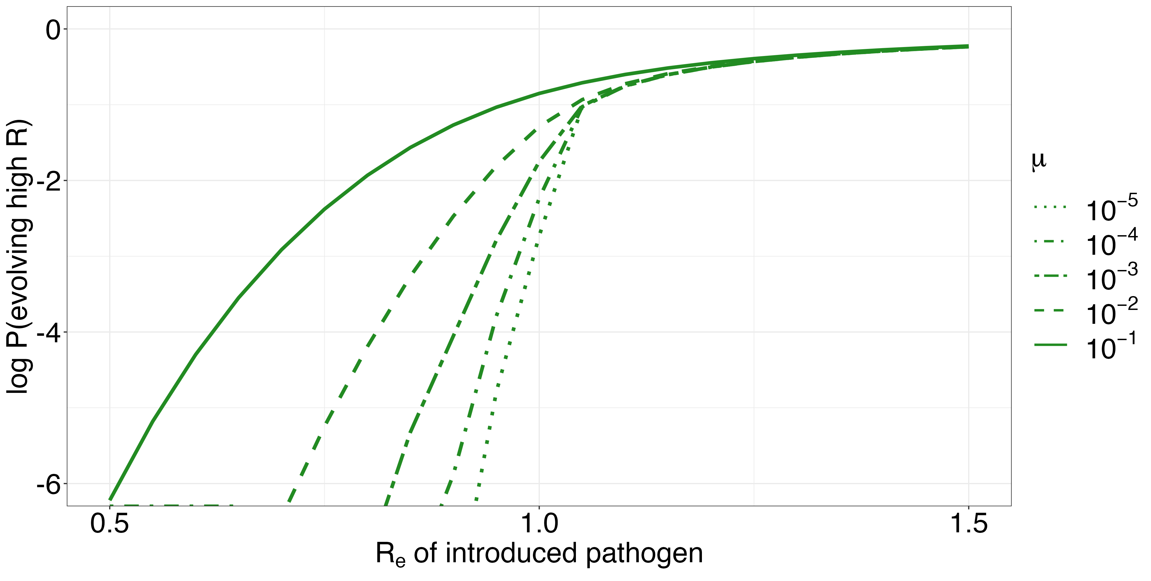
A.
B.
0
-2
-4
-6
0
-2
-4
-6
Log10 P(evolving high R)
0.5 1.0 1.5
0.5 1.0 1.5
R_{e} of introduced pathogen

Slide 7
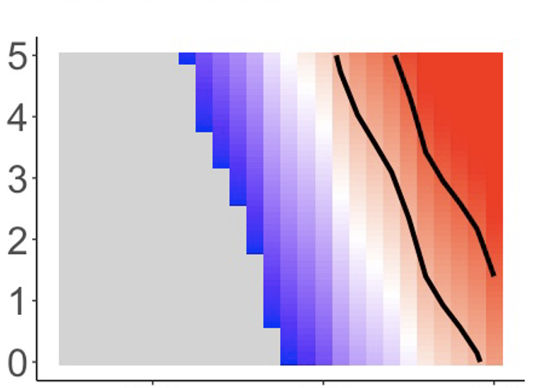
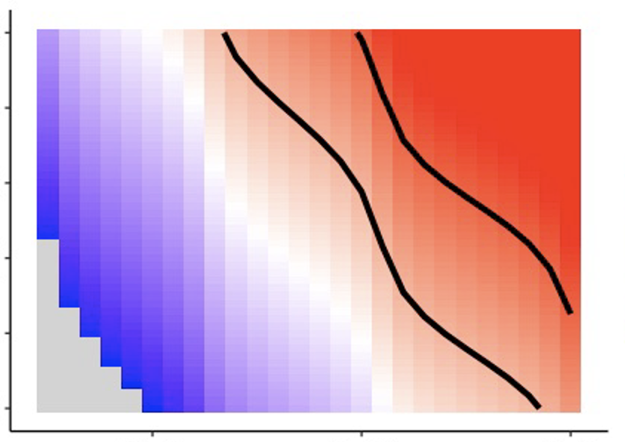
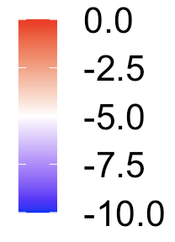
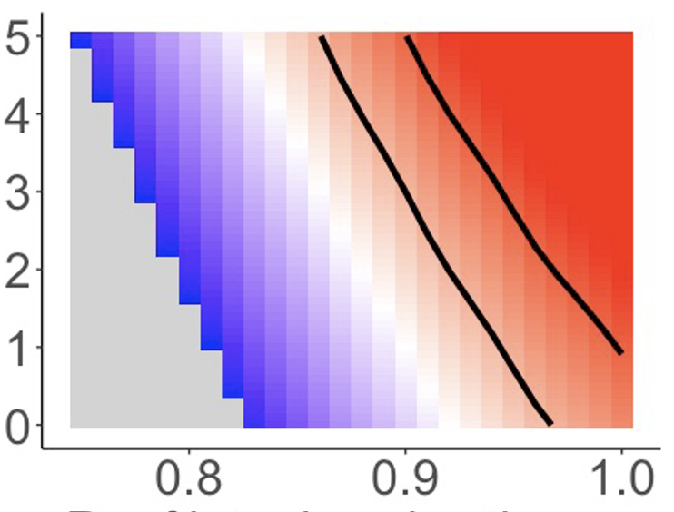
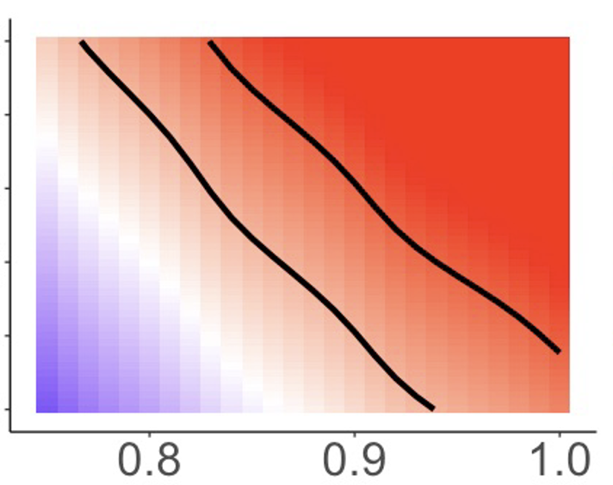
Increase in fitness with mutation, 𝛔
0.05 0.1
10⁻⁴
Log P(Emergence)
Beneficial mutation rate (infection⁻¹), 𝝁
Log10 spillover rate, year⁻¹
10⁻³
R_{e} of introduced pathogen
Notes:
Mutation^-1

Slide 8
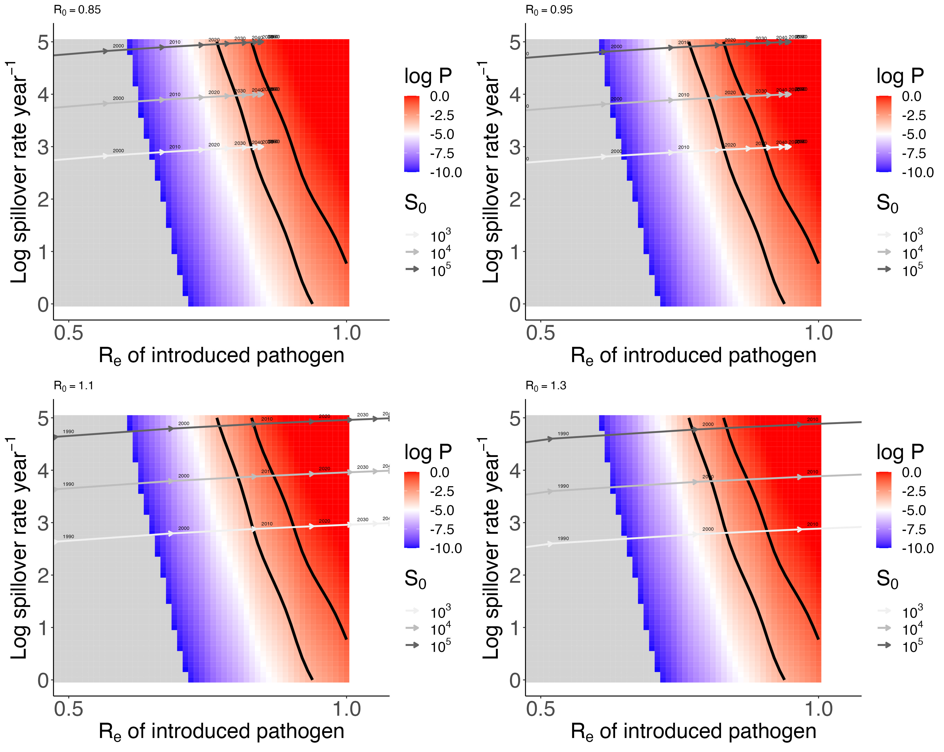
Notes:
Choose intermediat sigma/mu plot, pick some S0

Slide 9
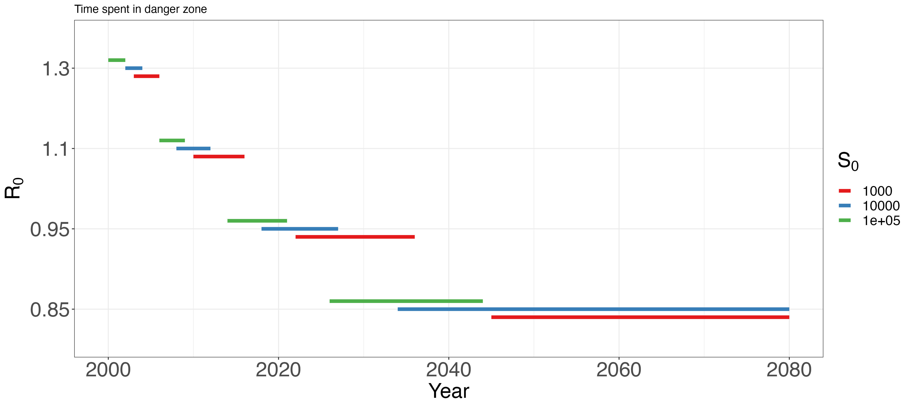

Slide 10
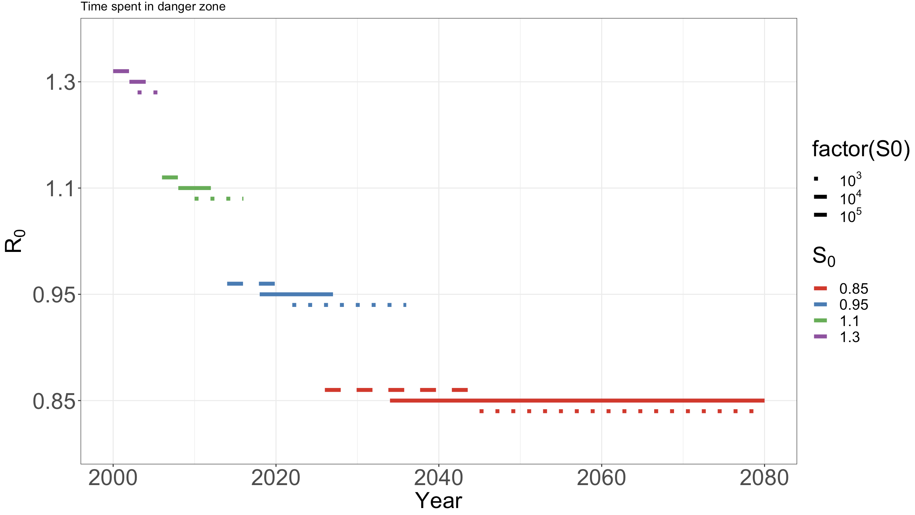
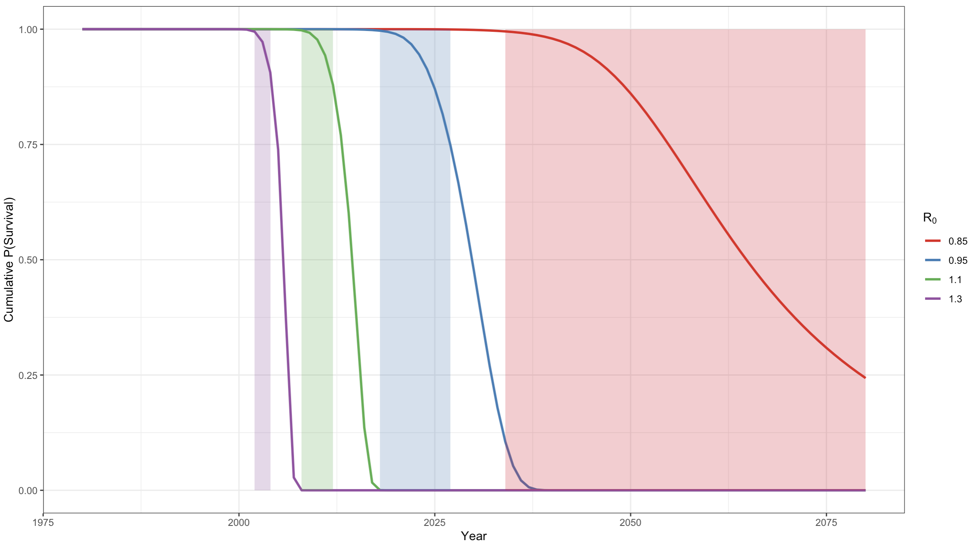

Slide 11
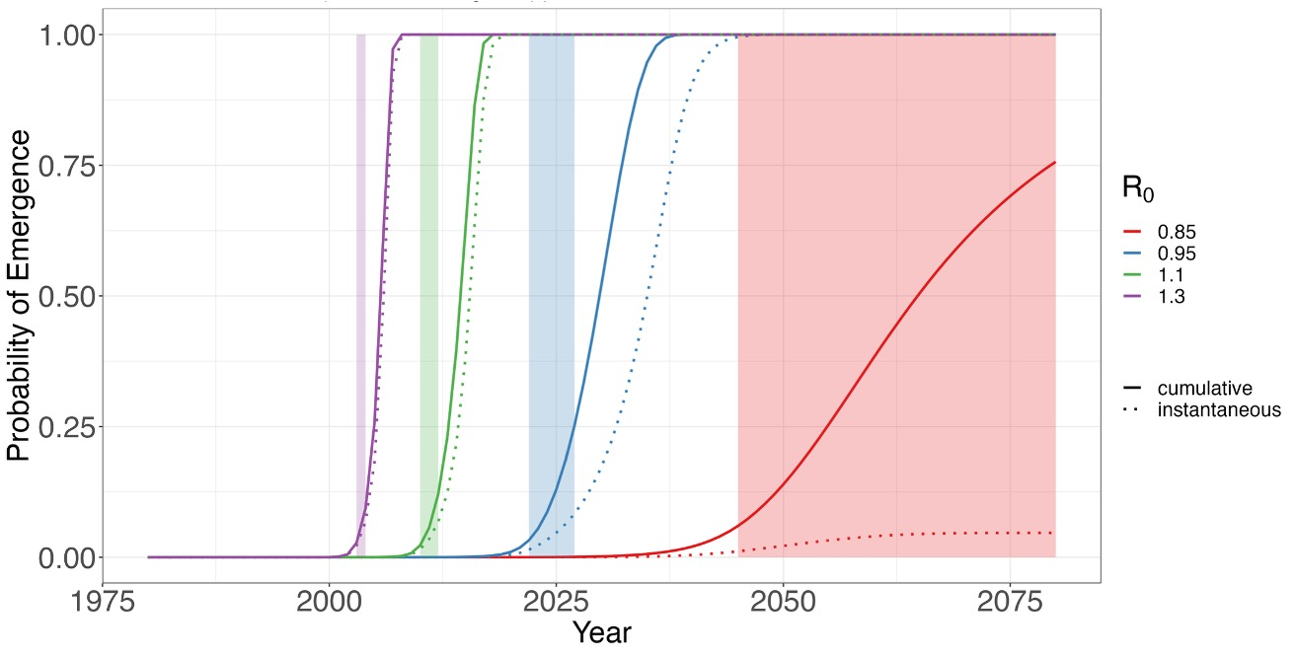

Slide 12
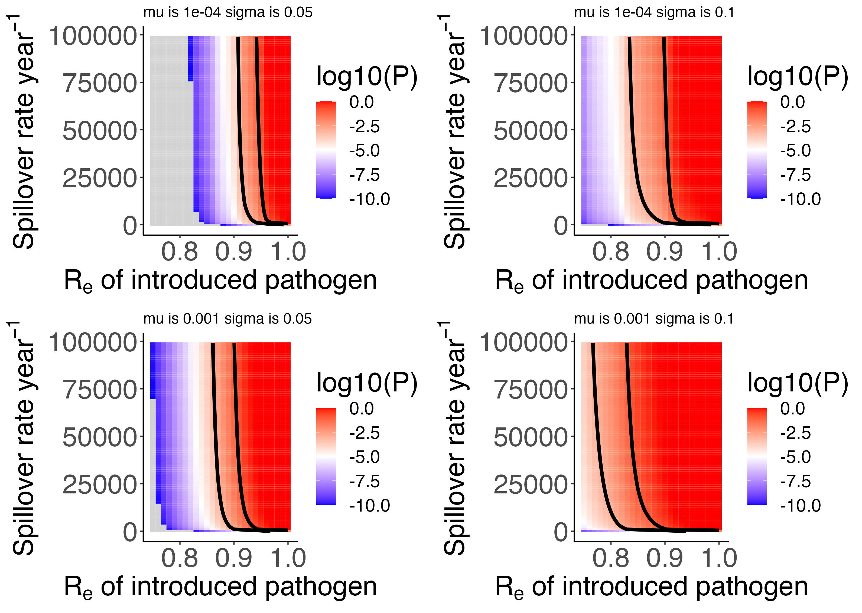

Slide 13
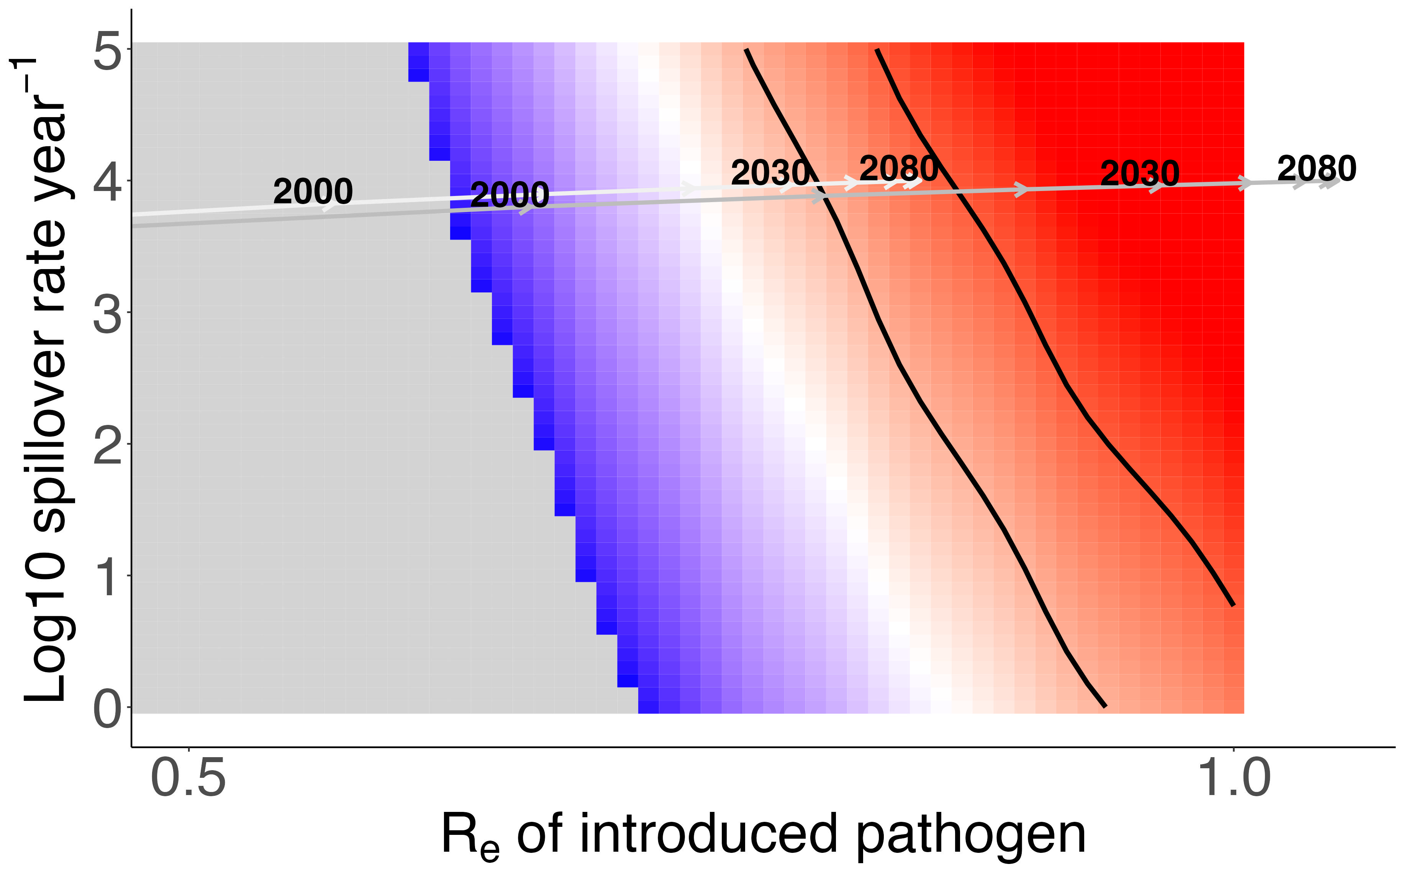
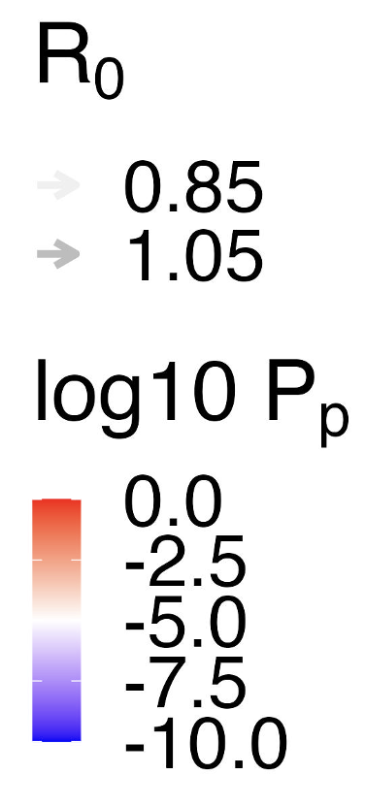

Slide 14
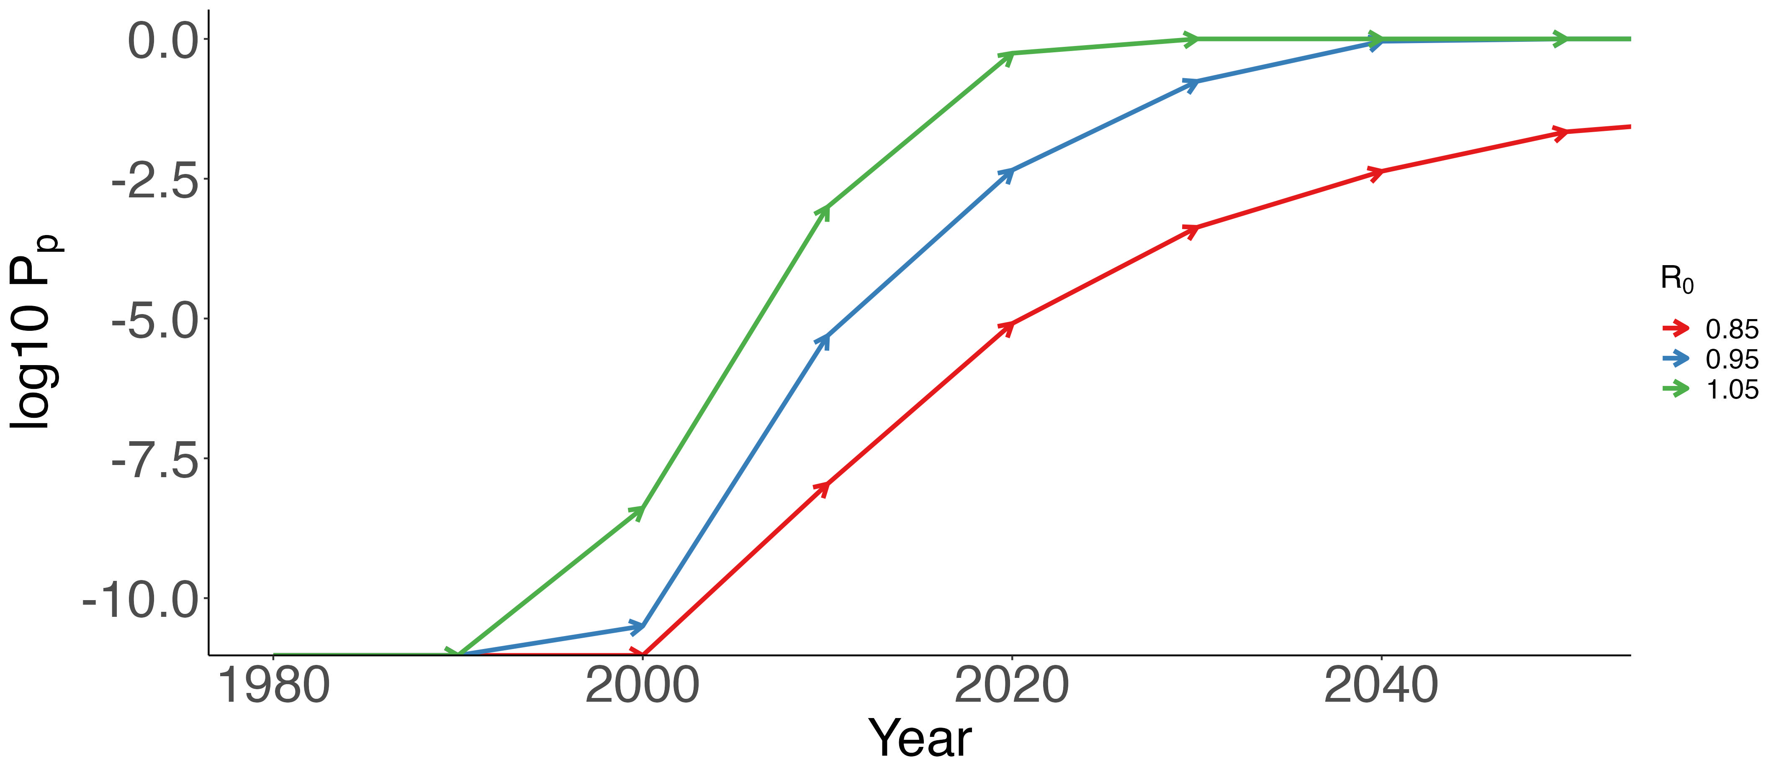

Slide 15
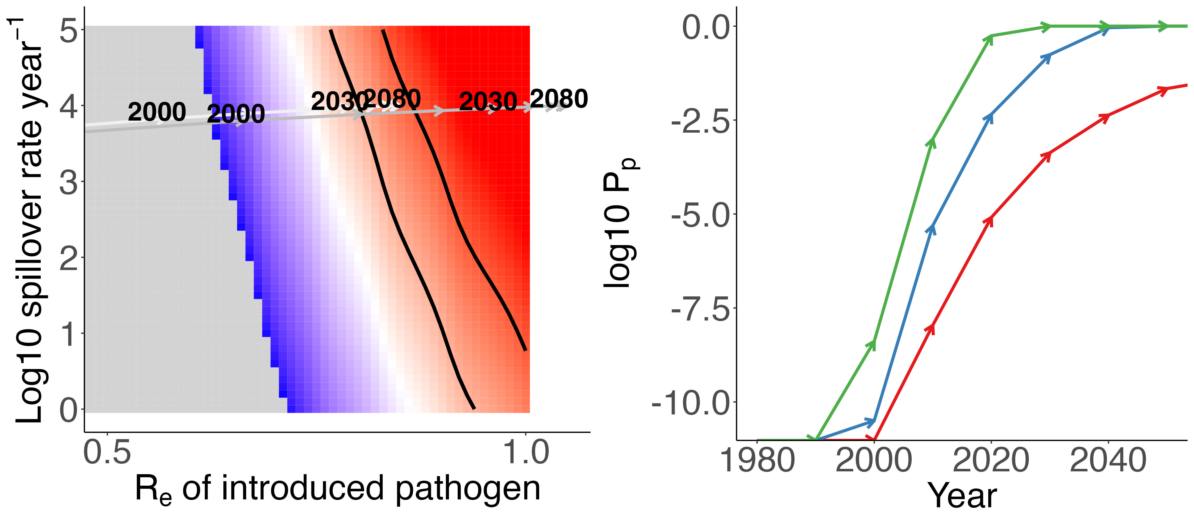
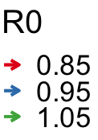
A.
B.

Slide 16
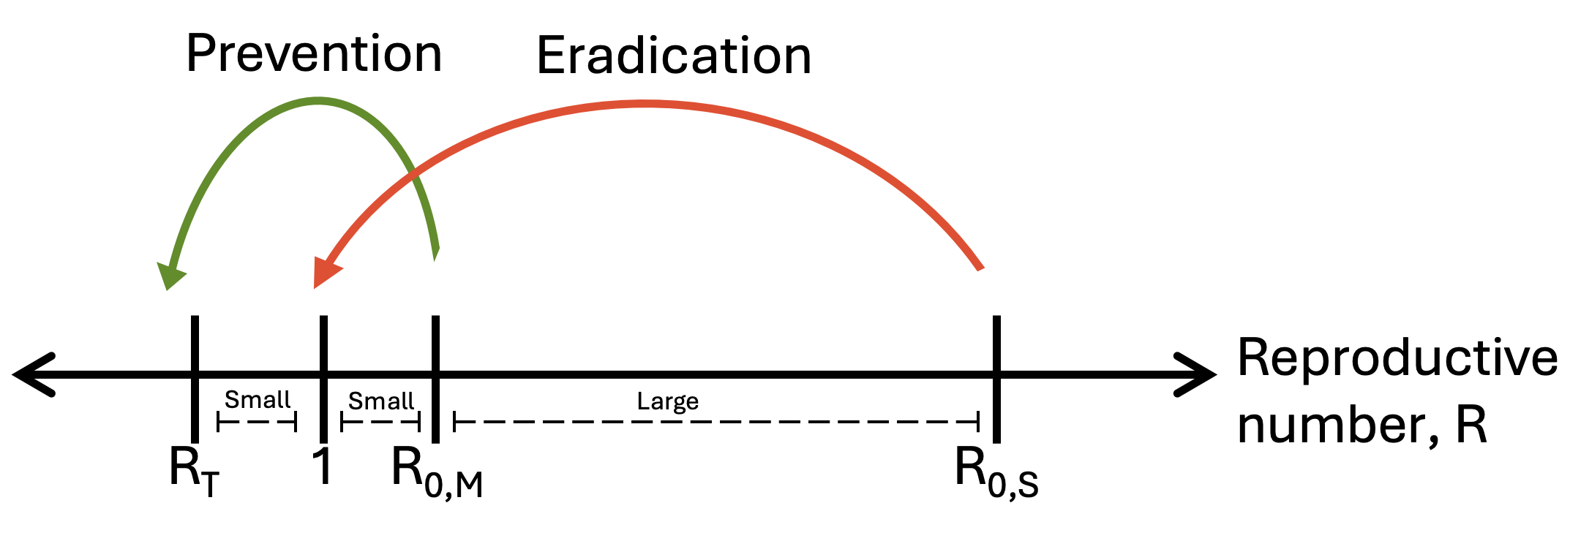
Small
Small
Large
0

Slide 17
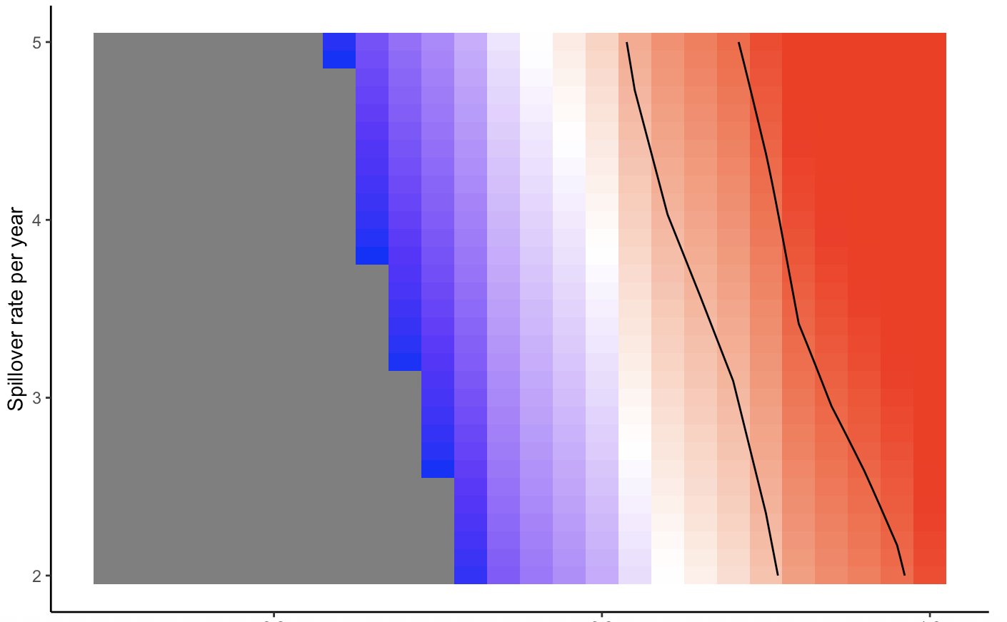
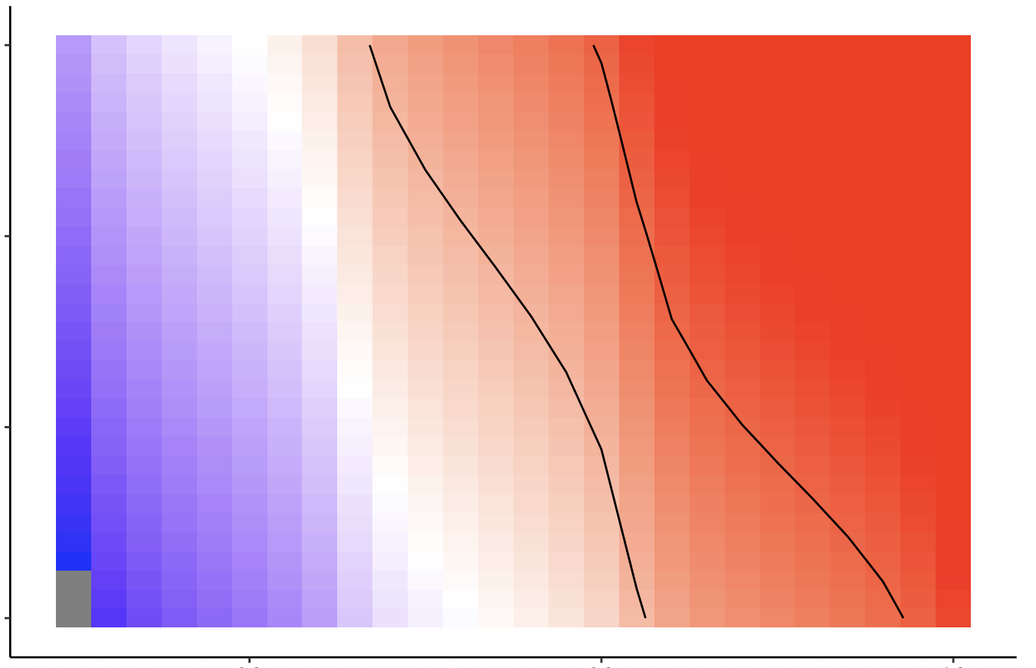
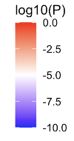
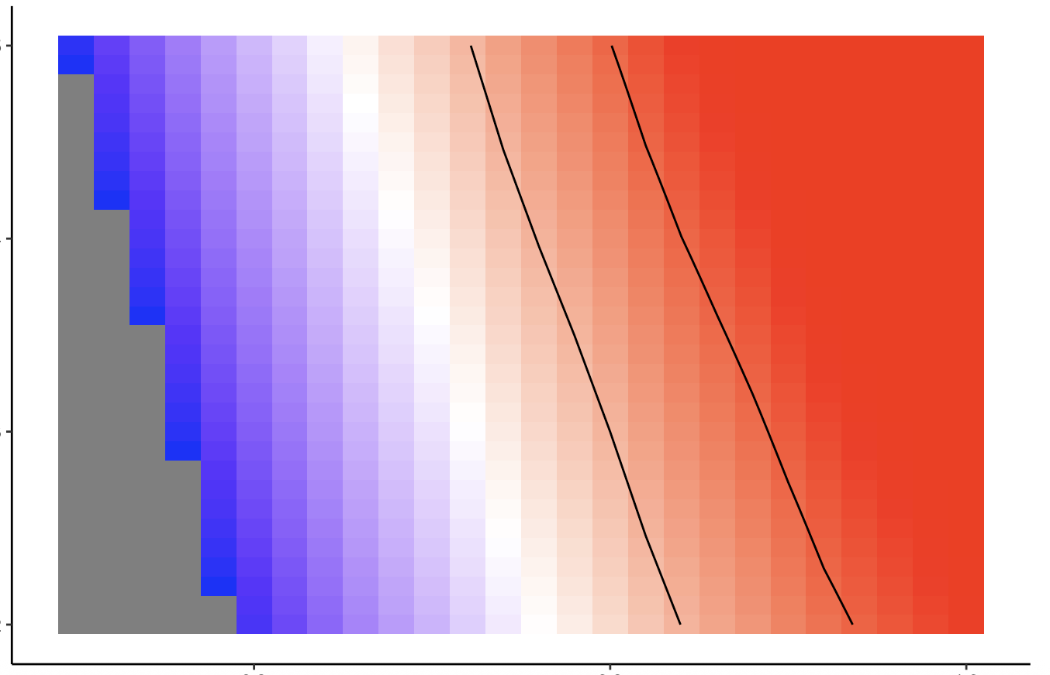
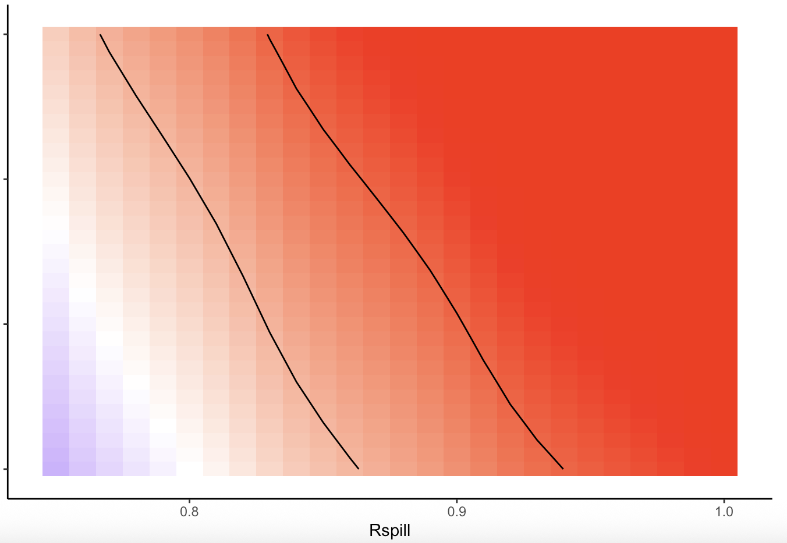
Reducing Re can be a more effective prevention strategy.
Increase in fitness with mutation
0.05 0.1
5
4
3
2
10⁻⁴
Beneficial mutation rate (per infection)
Log10 Spillover rate year⁻¹
5
4
3
2
10⁻³
0.8 0.9 1.0
0.8 0.9 1.0
R_{e} of introduced pathogen
Notes:
P(Emergence) changes more sharply with Re than S . Black contours show when probability of emergence per year is between 1 in 10 and 1 in 1000 years
And note that changing Re can be effective to reduce the probability of evolving high transmissibility after spillover (during outbreaks), while reducing spillovers will only reduce the probability of emergence before spillover.

Slide 18
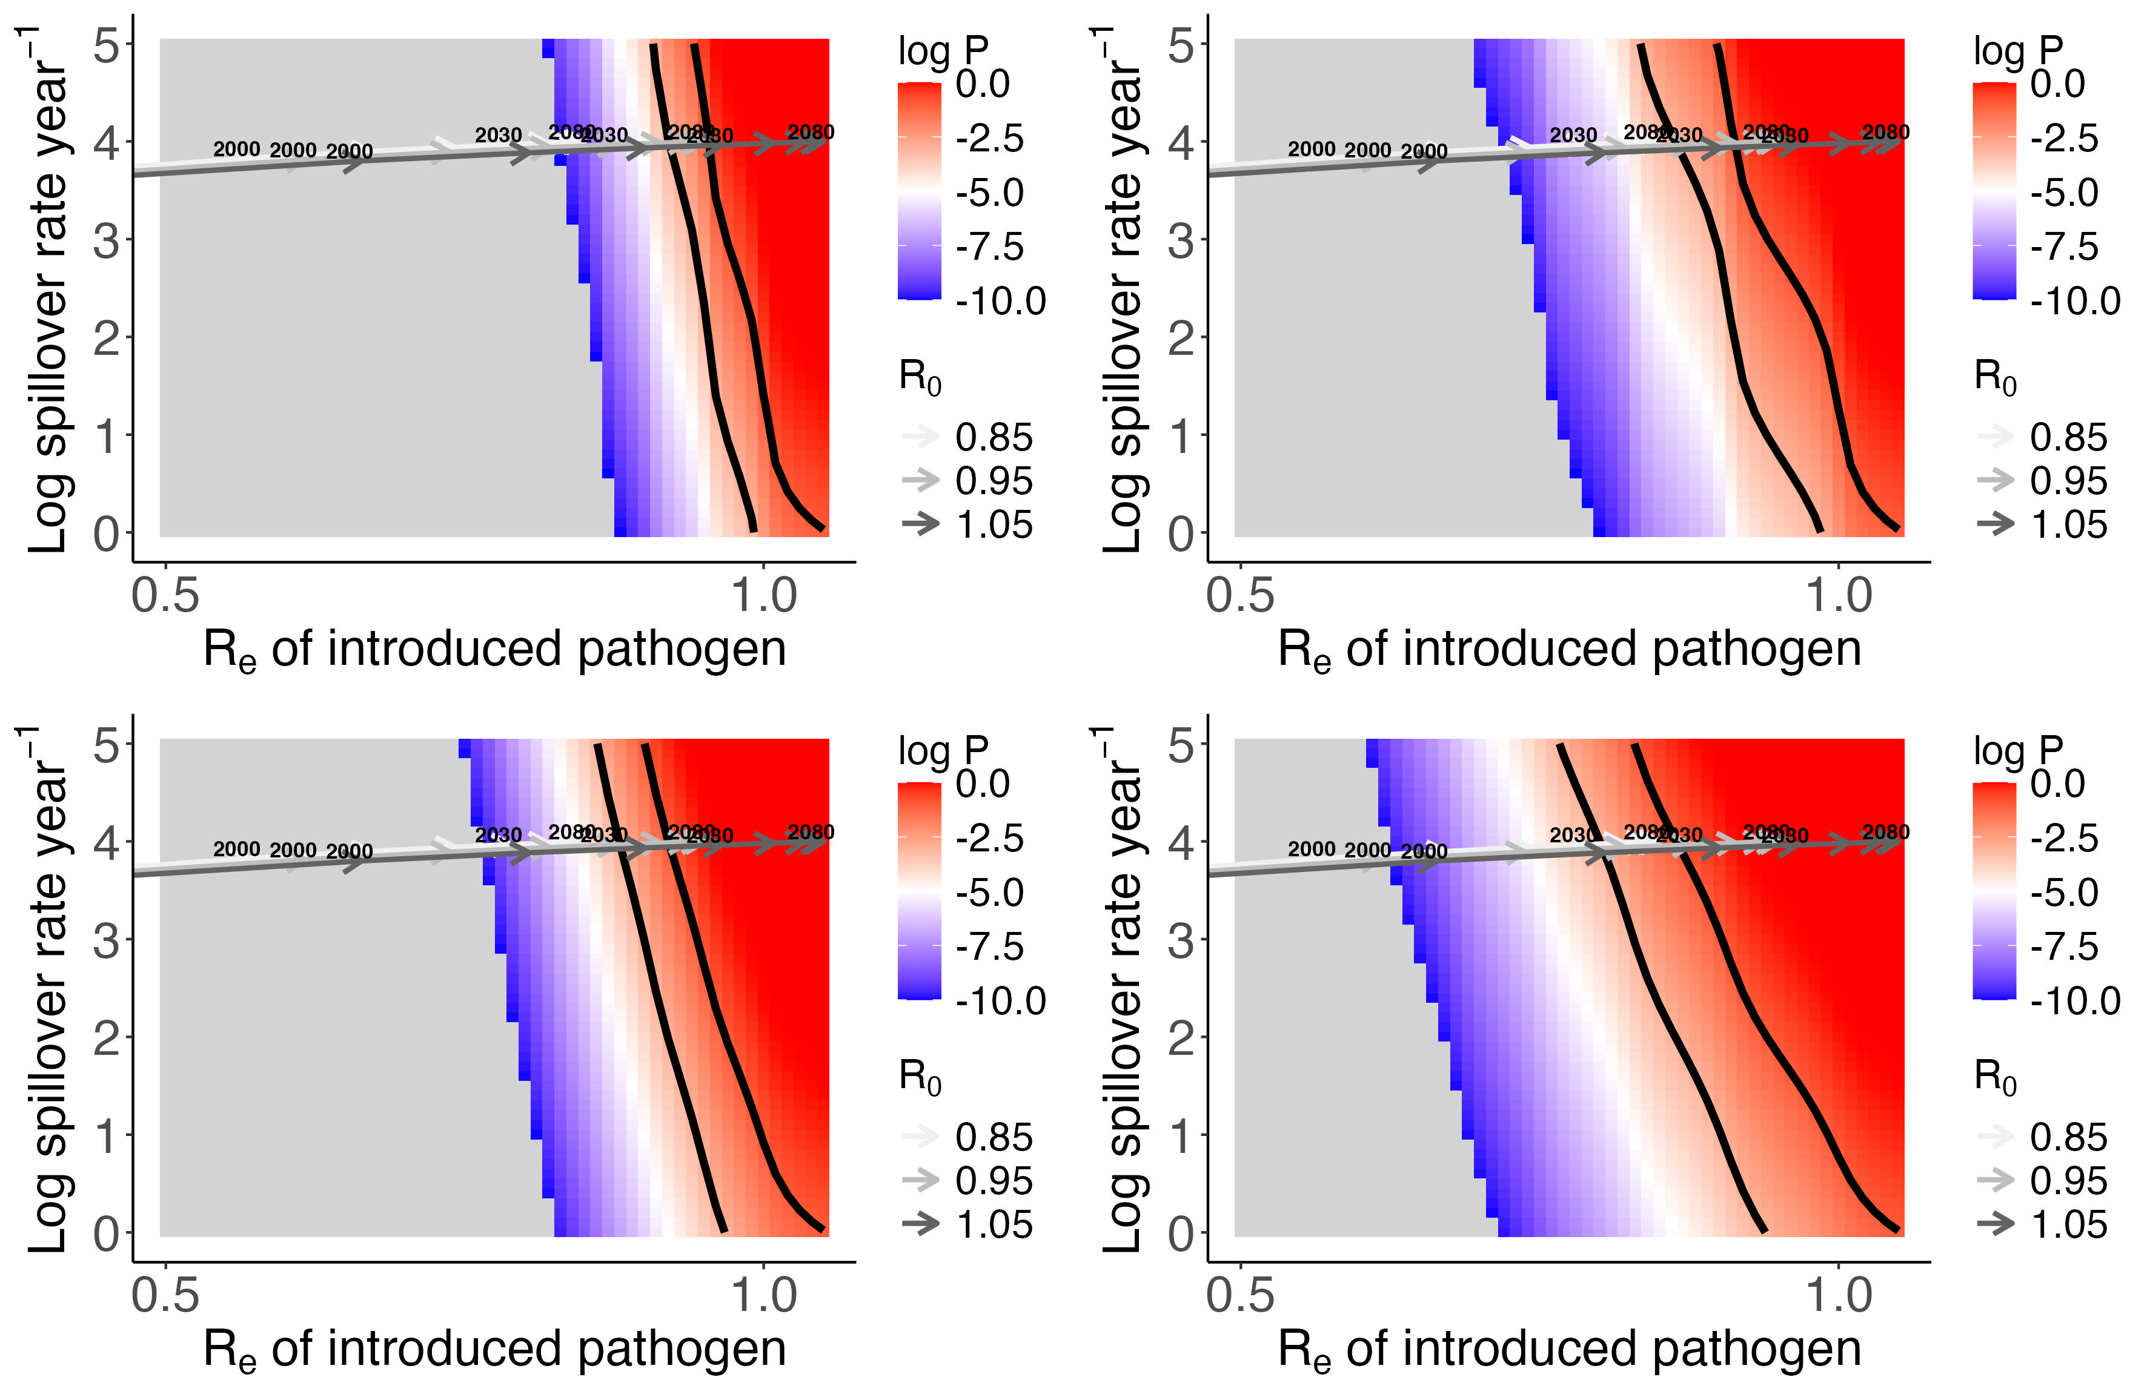
Increase in fitness with mutation, 𝛔
0.05 0.1
10⁻⁴
Beneficial mutation rate (infection⁻¹), 𝝁
Log P(Emergence)
Log10 Spillover rate year⁻¹
10⁻³
R_{e} of introduced pathogen

Slide 19
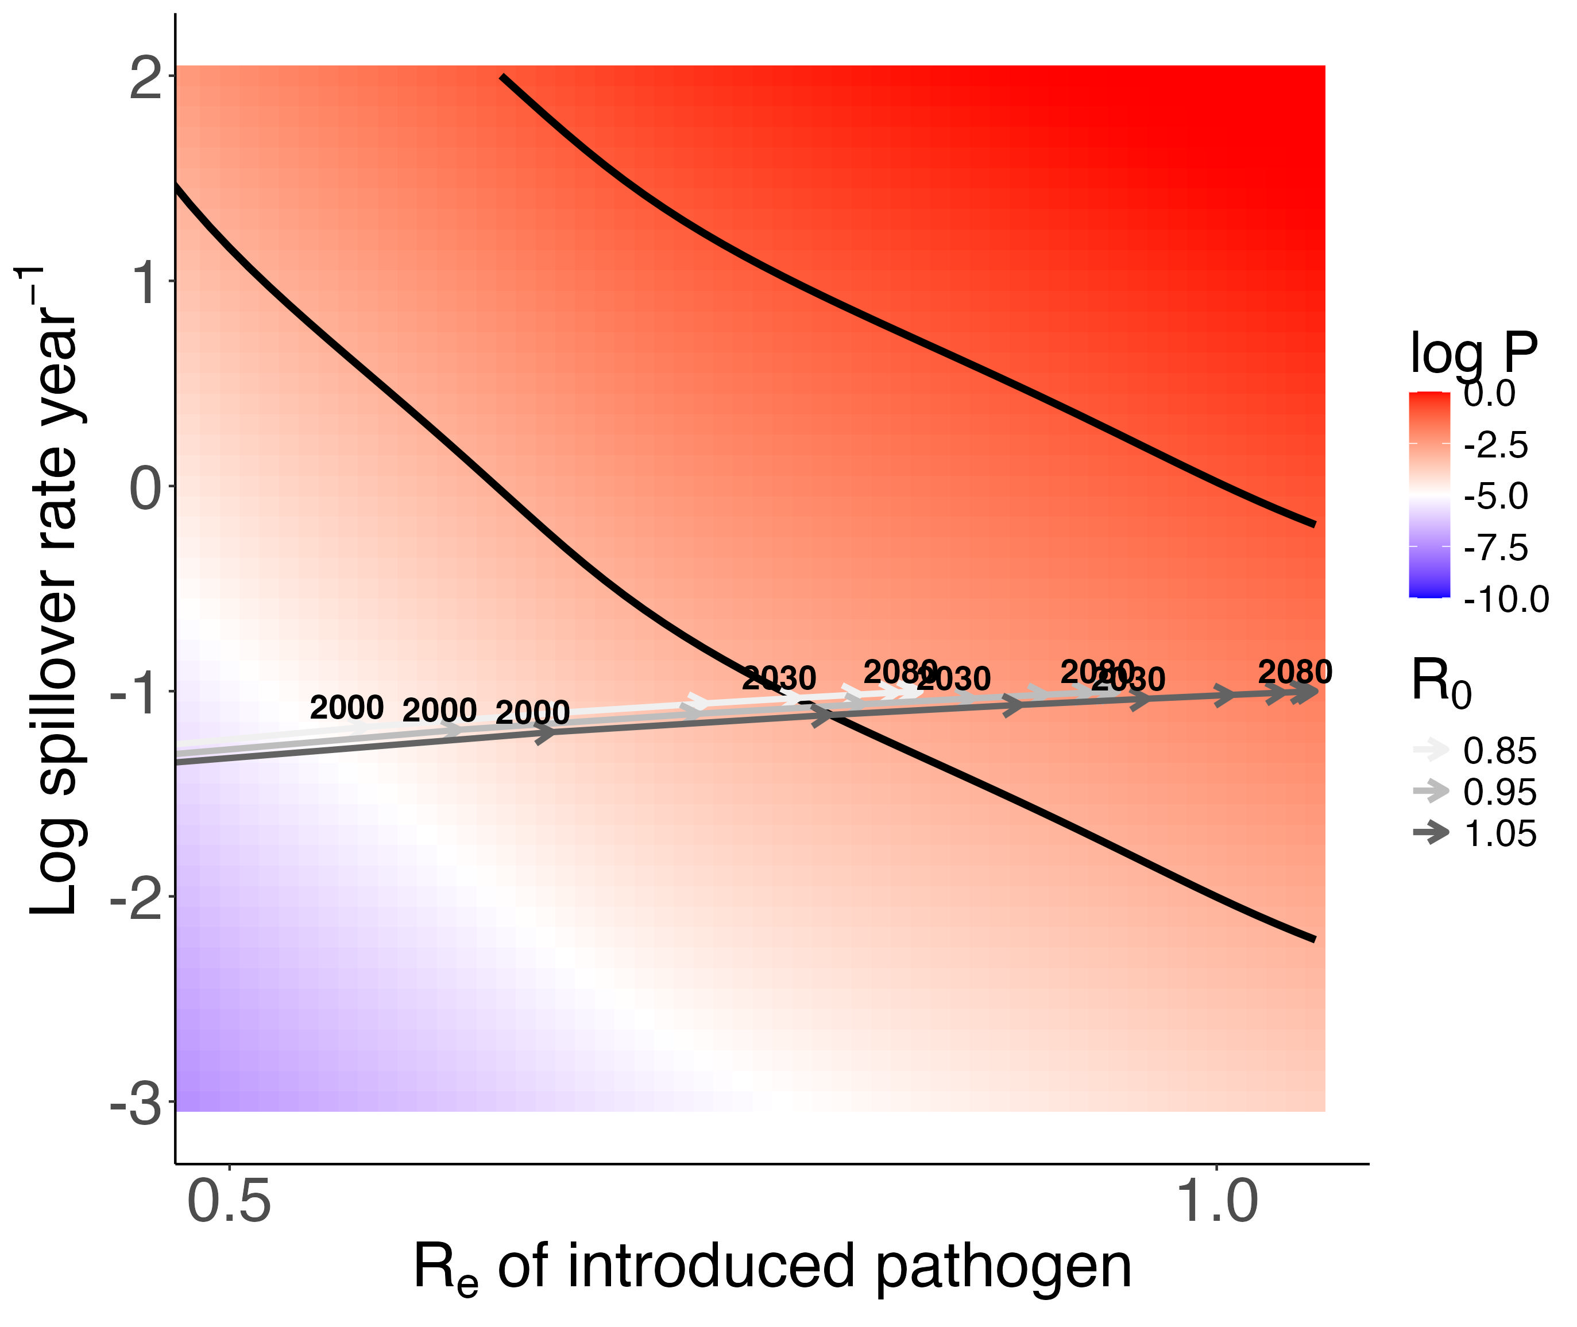

Slide 20
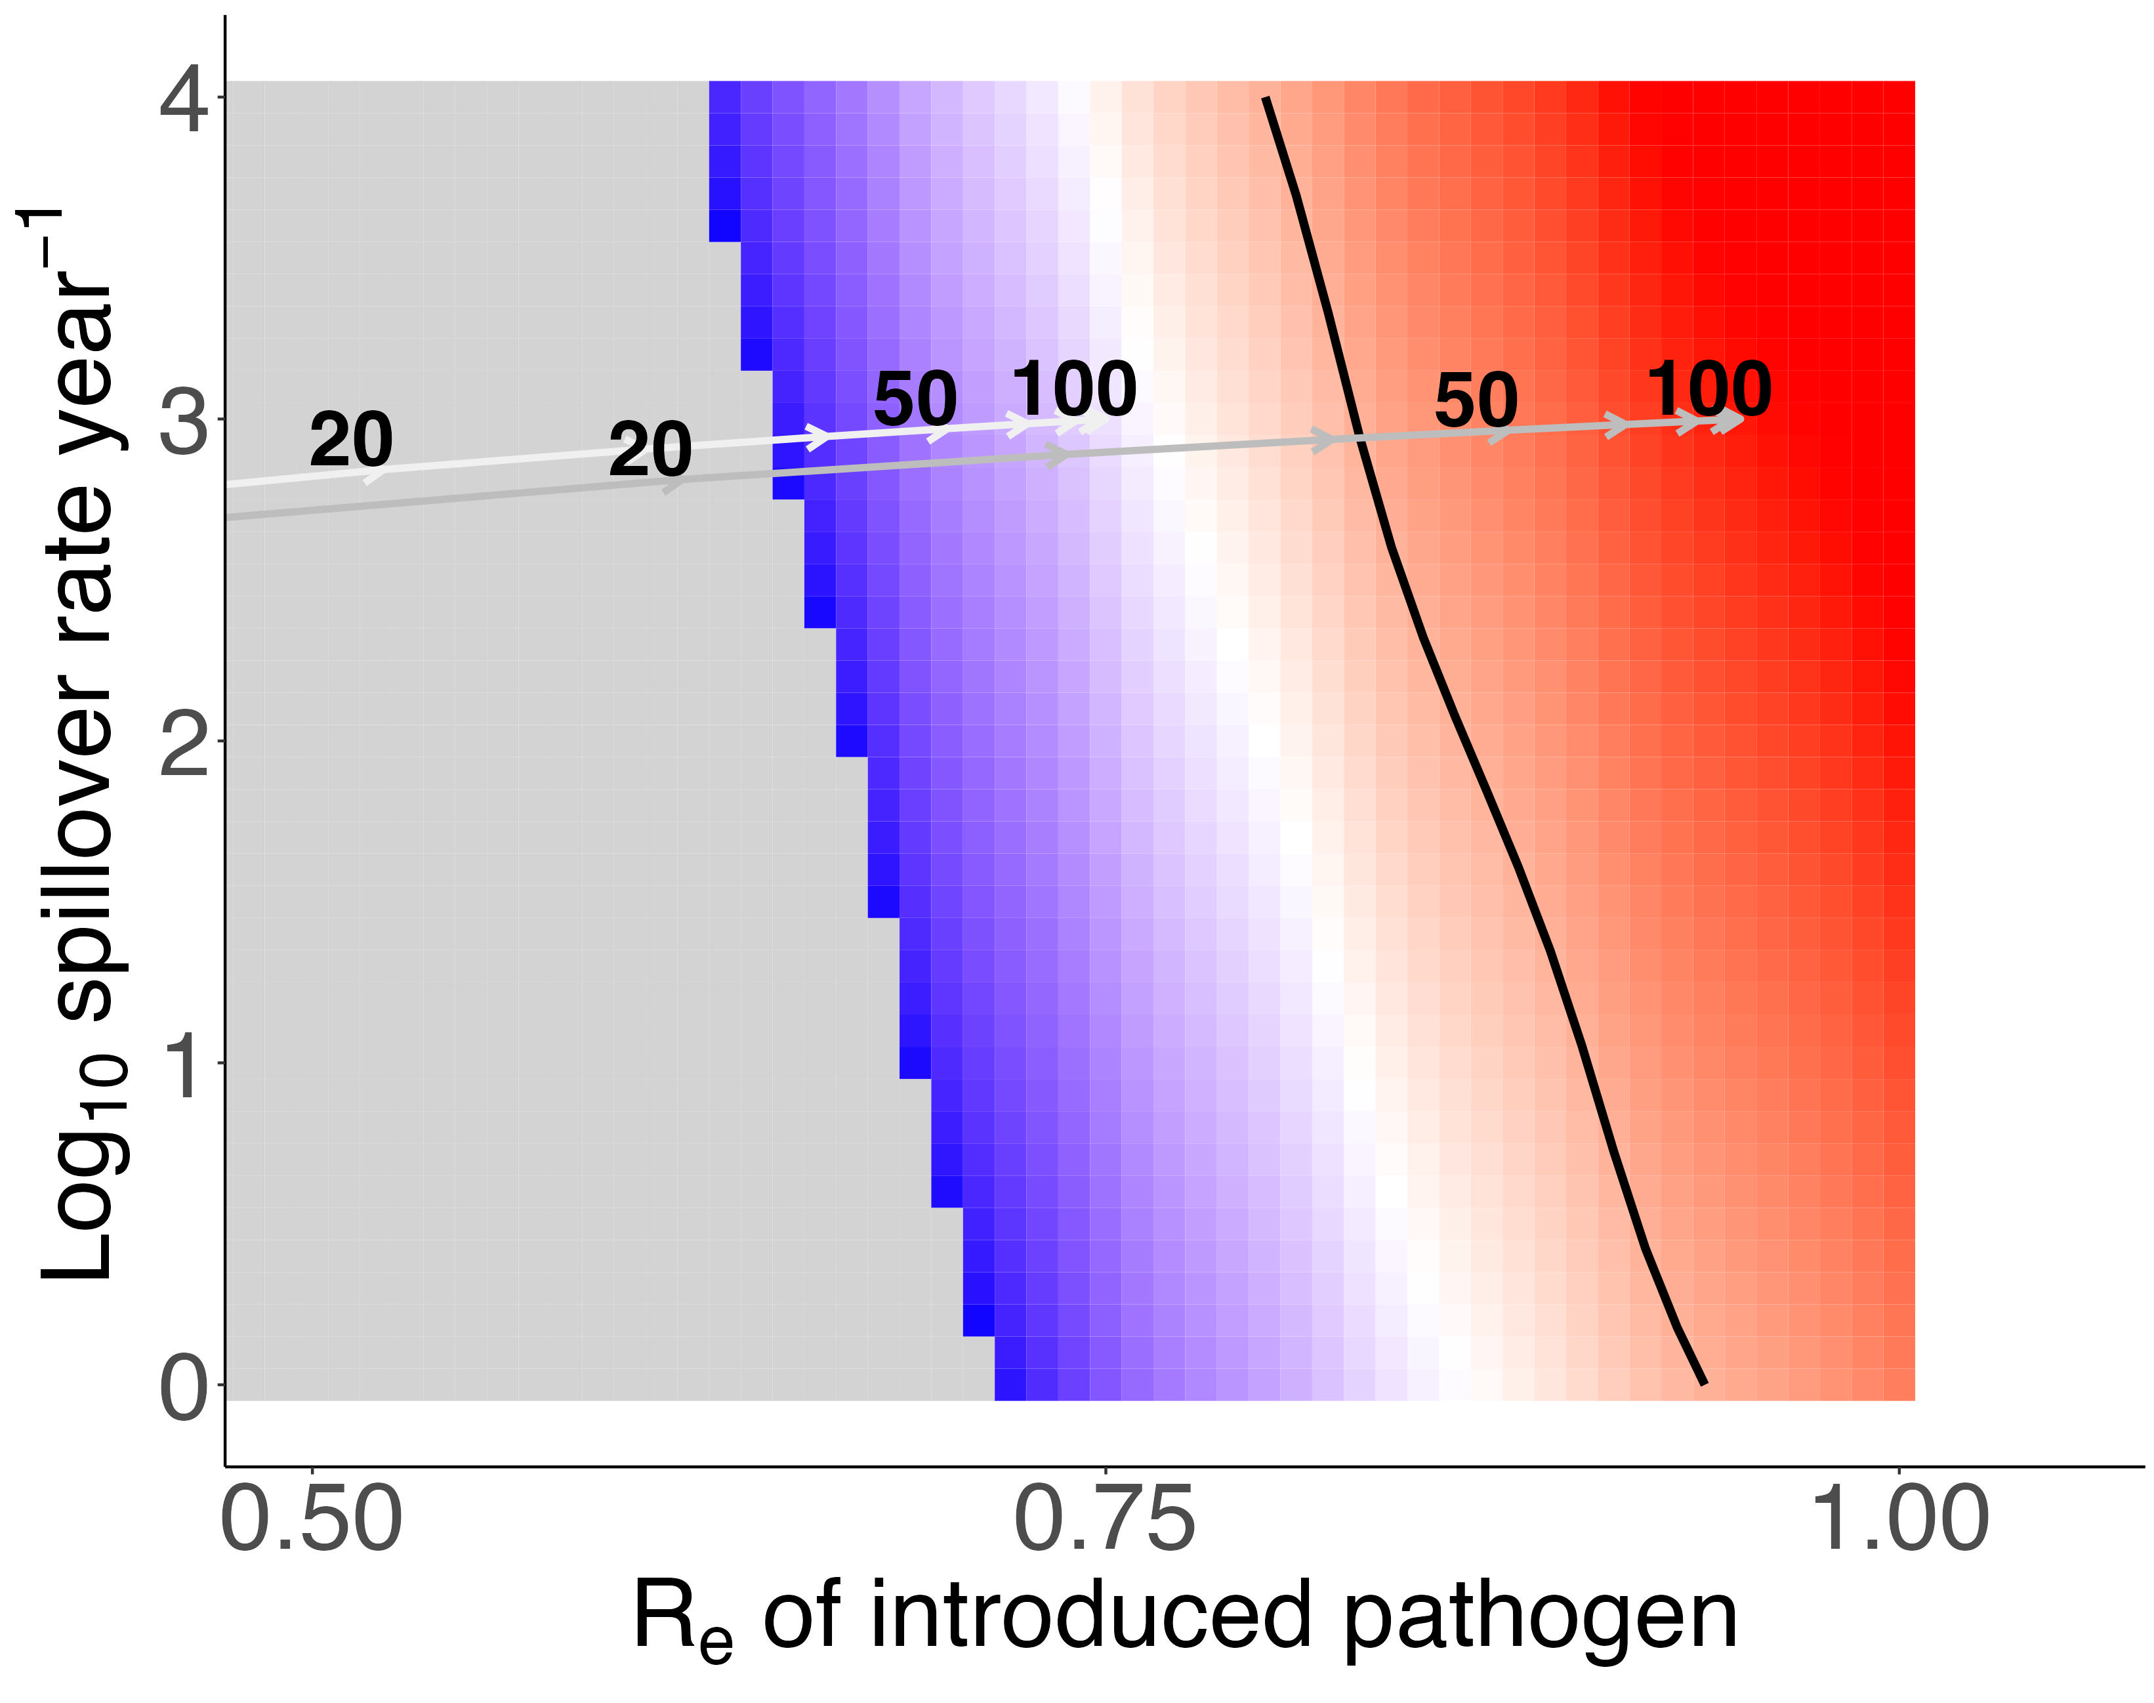
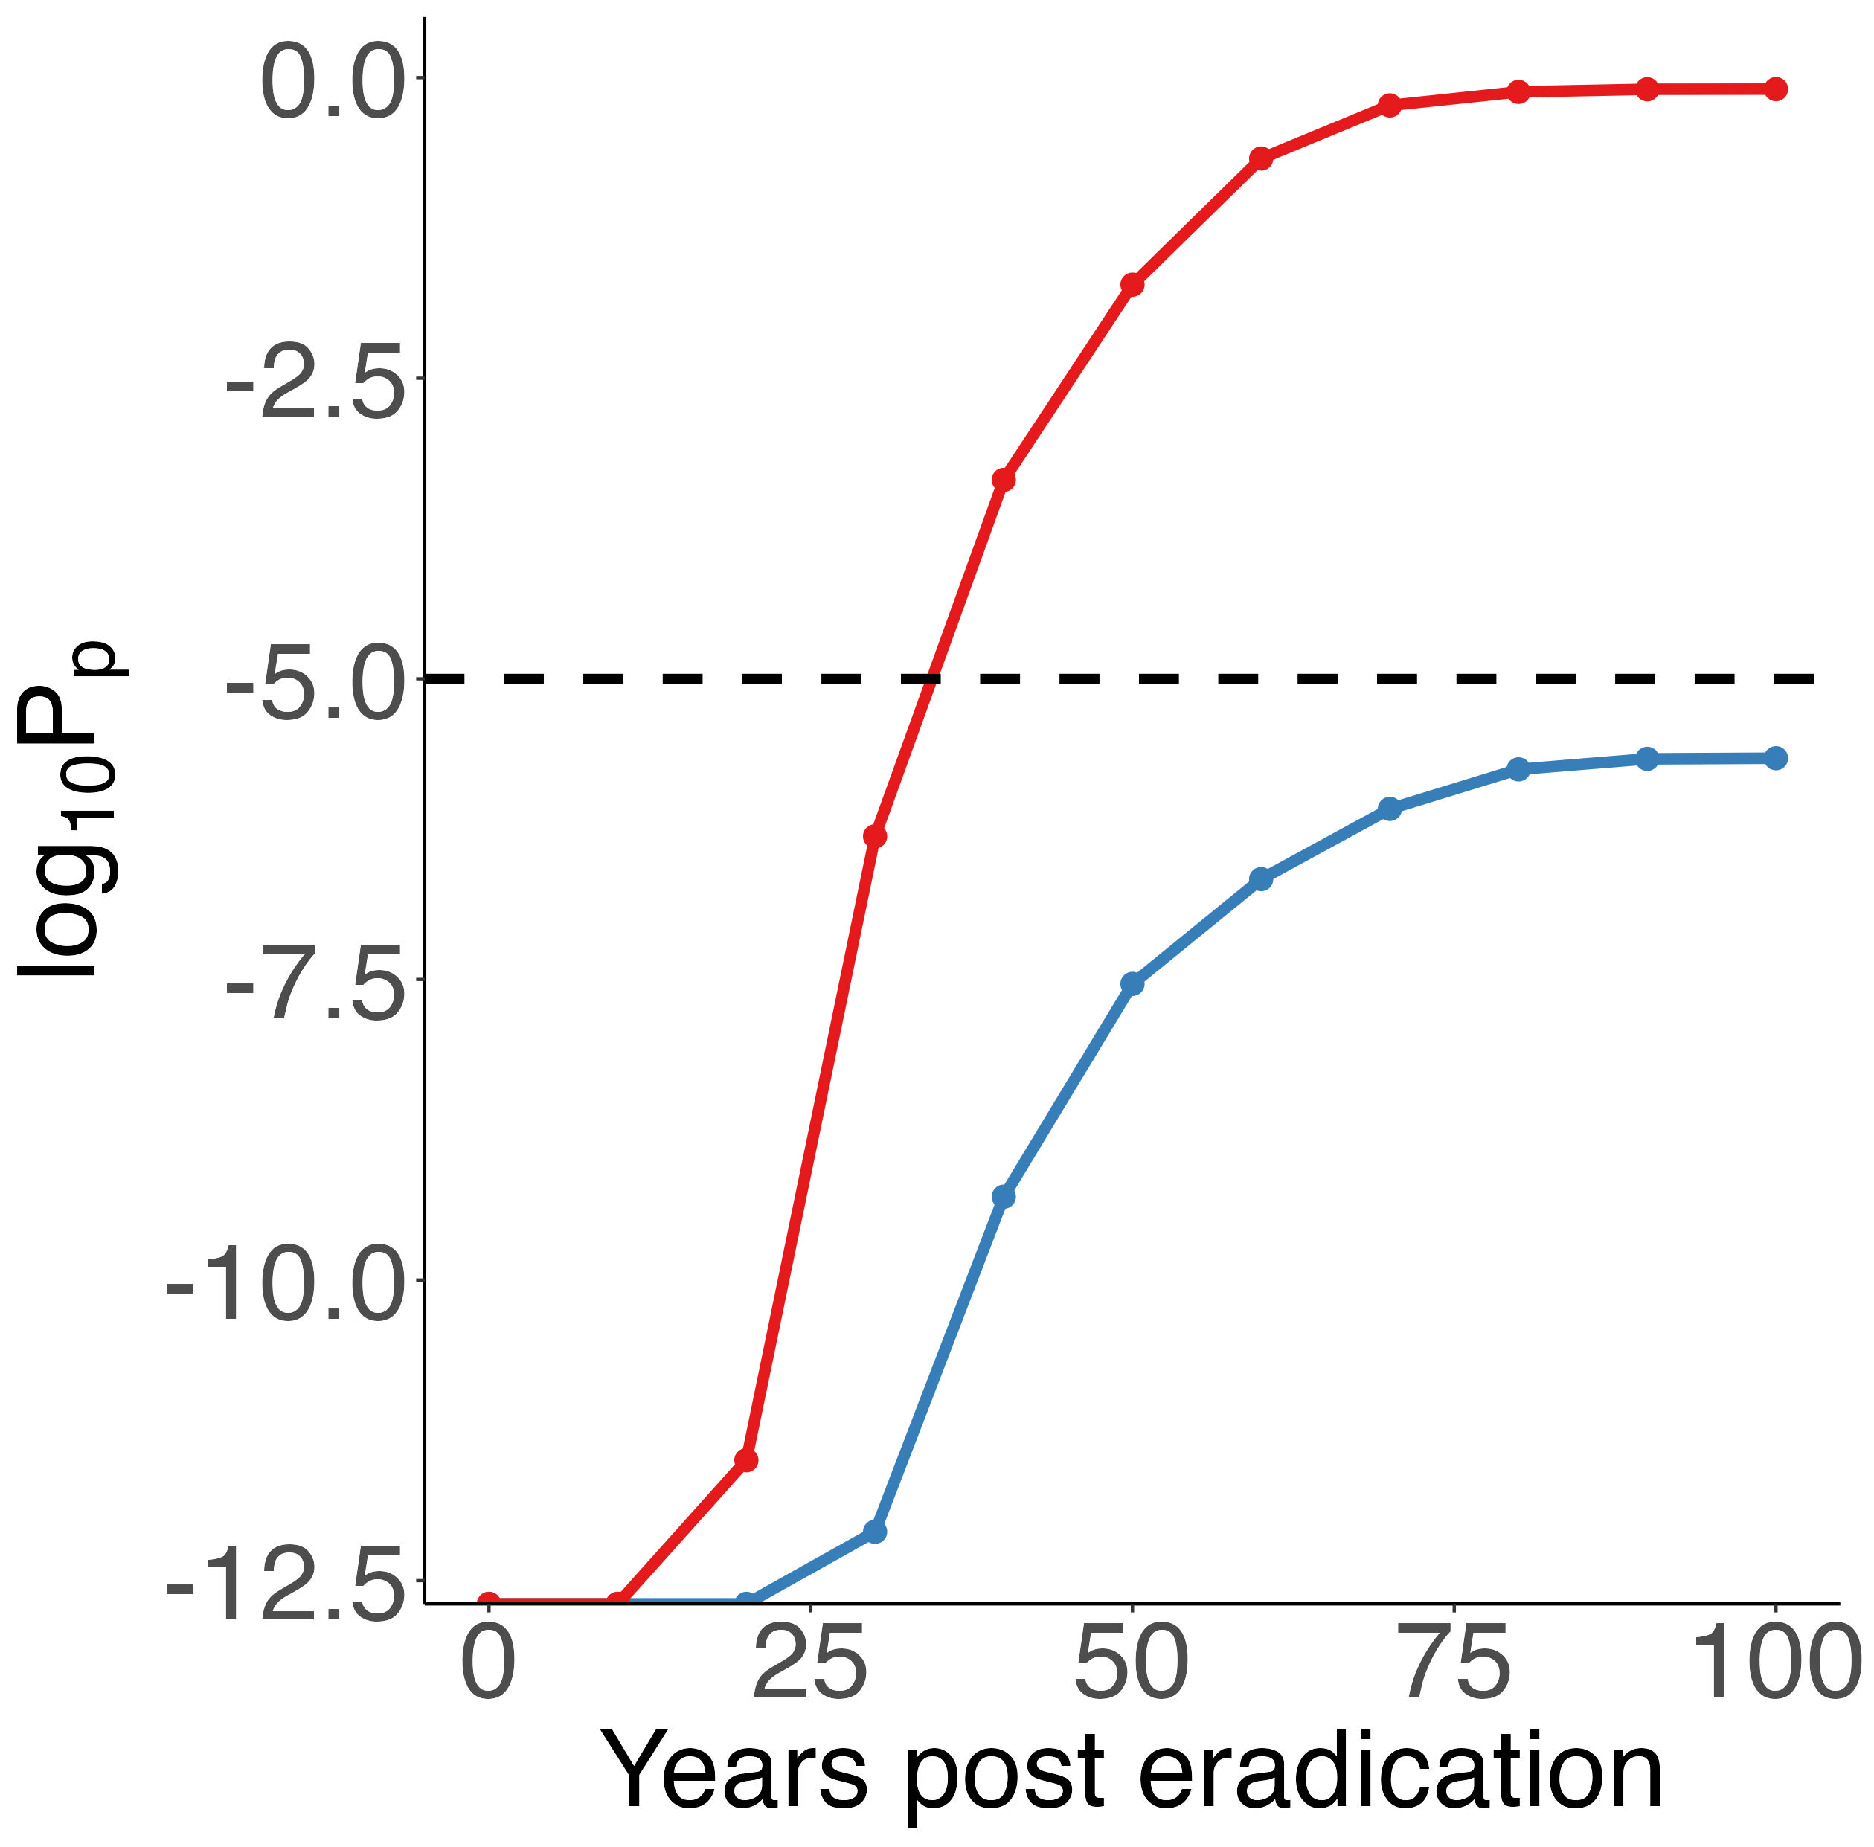
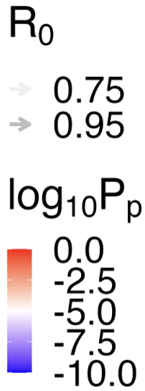
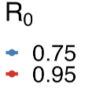
A.
B.

Slide 21
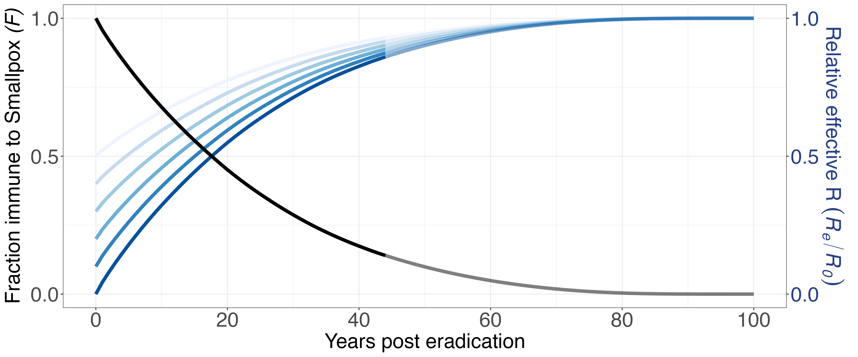
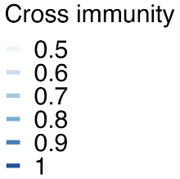

Slide 22
Revision 1

Slide 23
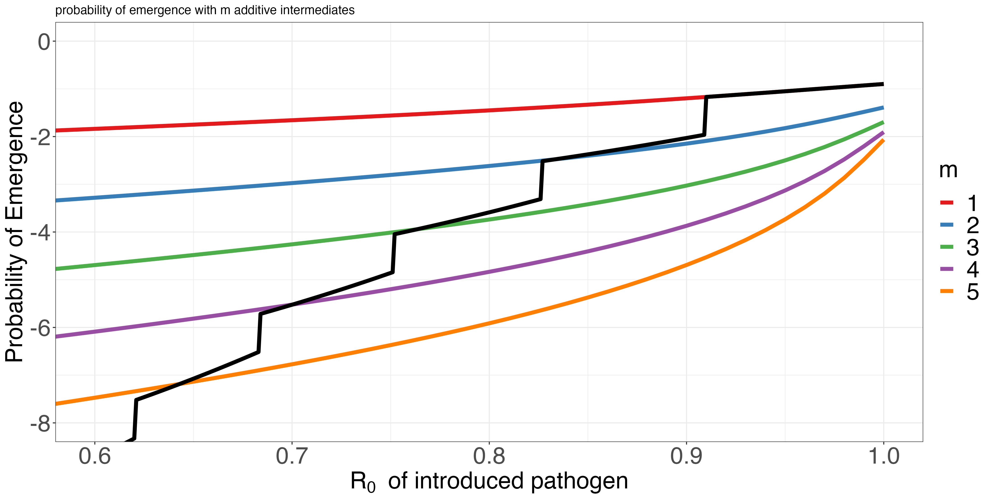
Supercritical
1 mutations away
2 mutations away
Number of mutations required, additive model (Antia et al 2003)
Probability of becoming supercritical before extinction
3 mutations away
4 mutations away
5 mutations away
R₀ of introduced pathogen

Slide 24
Reproductive Number, R
R_{0,Spillover}
R_{0,Evolved}
R_{e} increases toward R₀
as immunity wanes
Evolution after spillover continues to increase R₀
Effort required for control

